Slide 1


Saudi Stock Market
Presented by Munther ALnghemshi

Slide 2
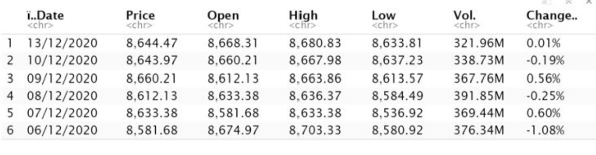
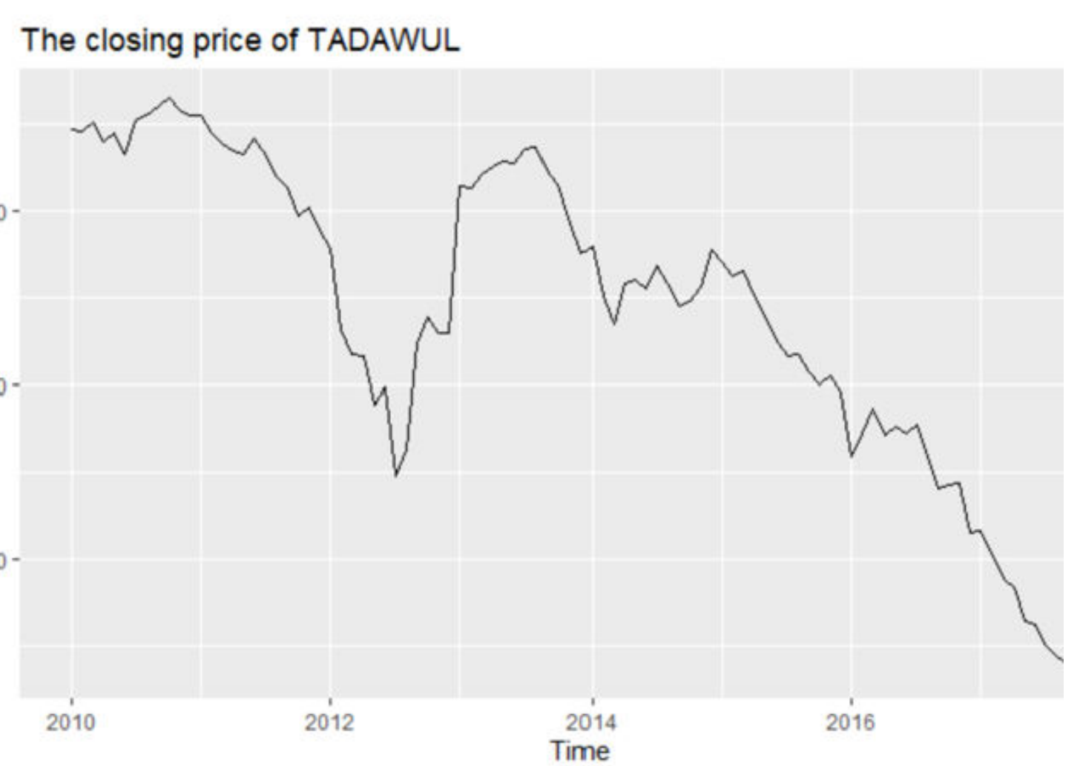
DATA and Objective
The objective is to apply different forecasting predictive models for the Saudi stock market daily close price. The models will be evaluated, analysed and compared, following the main course project directions.
This project describes different time series and machine learning forecasting models applied to a Sadui stock market (Tadawuel) close price for he past 10 years, up untill the the end of last month data. The data will be divided 70/30. I will divie into analyzing the first 7 years of the data going from 2010 - 2017, and leave the last 3 years (2017-2020) to compare the out come.

Slide 3
Used Model on the data
ARIMA
Prophet
FFNN

Slide 4
ARIMA Model
ARIMA is the abbreviation for AutoRegressive Integrated Moving Average. Auto Regressive (AR) terms refer to the lags of the differenced series, Moving Average (MA) terms refer to the lags of errors and I is the number of differences used to make the time series stationary.

Slide 5
AR term refers to the past values used for forecasting the next value. The AR term is defined by the parameter ‘p’ in arima. The value of ‘p’ is determined using the PACF plot.
MA term is used to defines number of past forecast errors used to predict the future values. The parameter ‘q’ in arima represents the MA term. ACF plot is used to identify the correct ‘q’ value.
Order of differencing specifies the number of times the differencing operation is performed on series to make it stationary. Test like ADF and KPSS can be used to determine whether the series is stationary and help in identifying the d value.

Slide 6
Steps for ARIMA implementation
Load the data: The first step for model building is of course to load the dataset
Preprocessing: Depending on the dataset, the steps of preprocessing will be defined. This will include creating timestamps, converting the dtype of date/time column, making the series univariate, etc.
Make series stationary: In order to satisfy the assumption, it is necessary to make the series stationary. This would include checking the stationarity of the series and performing required transformations
Determine d value: For making the series stationary, the number of times the difference operation was performed will be taken as the d value
Create ACF and PACF plots: This is the most important step in ARIMA implementation. ACF PACF plots are used to determine the input parameters for our ARIMA model
Determine the p and q values: Read the values of p and q from the plots in the previous step
Fit ARIMA model: Using the processed data and parameter values we calculated from the previous steps, fit the ARIMA model
AUTO.ARIMA() can be used instead of steps 4-7
Predict values on validation set: Predict the future values
Calculate RMSE: To check the performance of the model, check the RMSE value using the predictions and actual values on the validation set

Slide 7
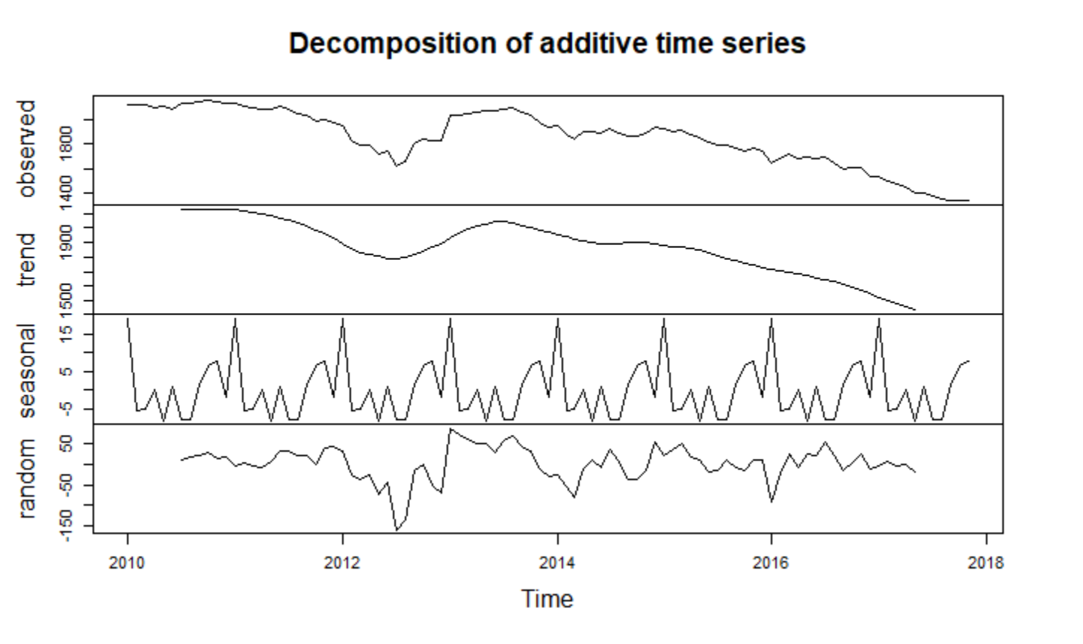
EDA (steps 1-2)
First, We need to understand the three components of a time series data:
1. Observed – the actual data plot
2. Trend – the overall upward or downward movement of the data
3. Seasonal – any seasonal pattern of the data
4. Random – random part of the data

Slide 8
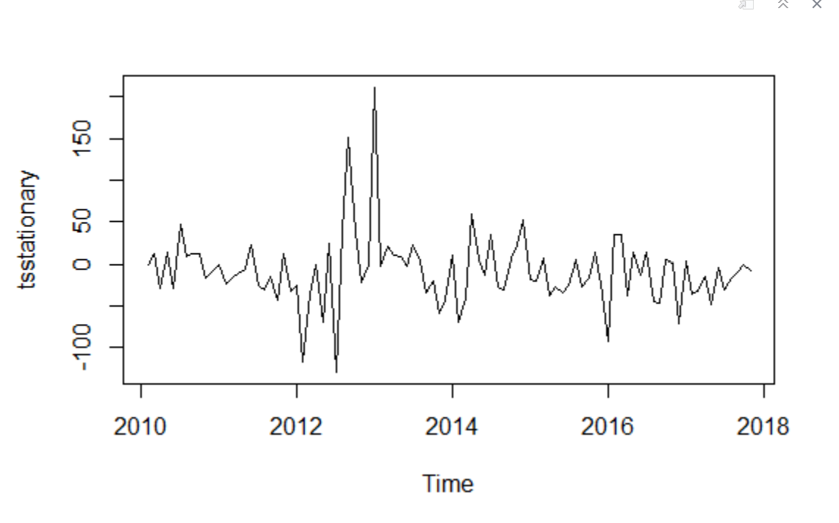
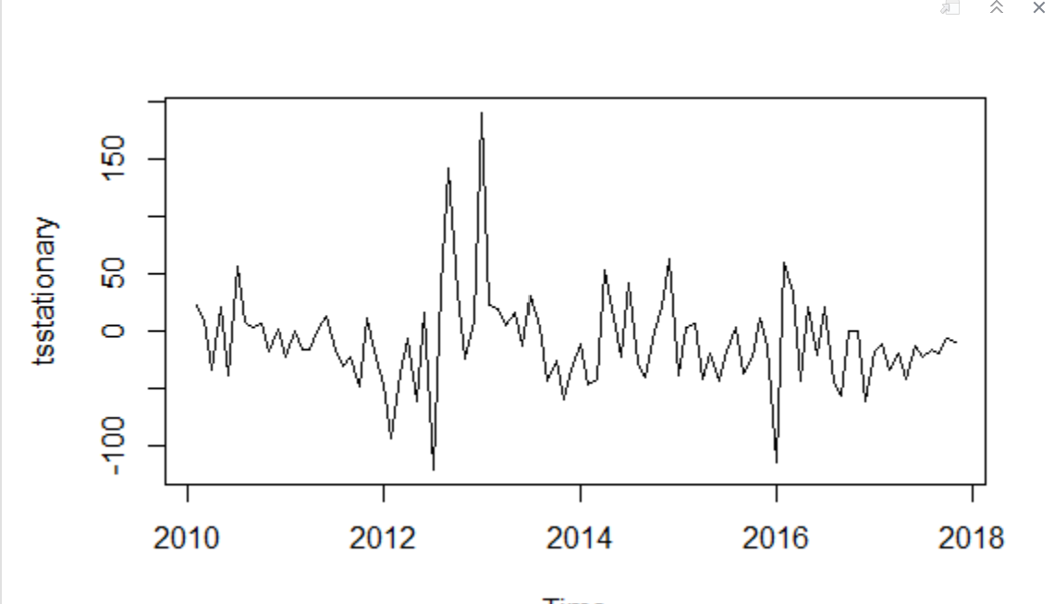
Removing non-stationary part for ARIMA (steps 3-4)
Non-Stationary (before removing)
To remove seasonality from the data, we subtract the seasonal component from the original series and then difference it to make it stationary.
After removing seasonality and making the data stationary, it will look like:
No difference noticed (d=0)
Stationary (After removing)

Slide 9
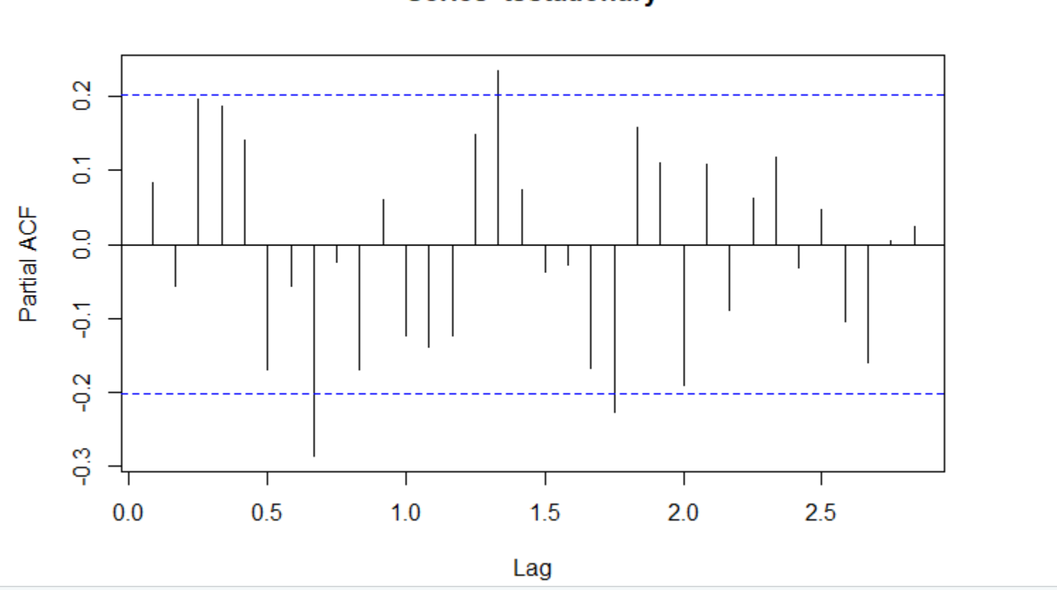
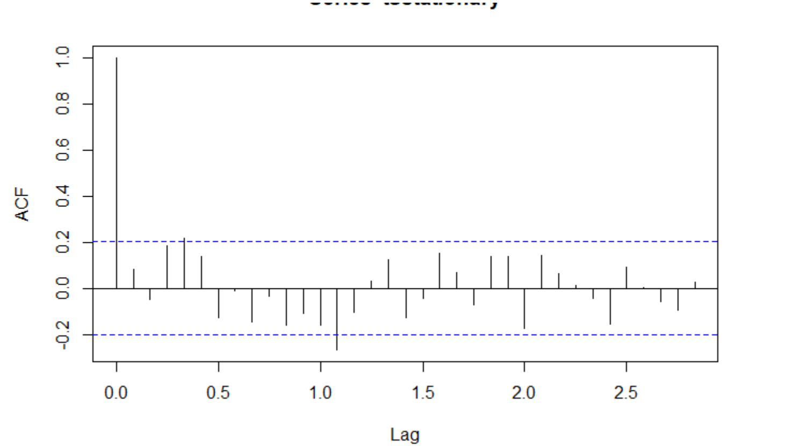
ACF and PACF plots (steps 5-7)
ACF and PACF for another stationary time series data. Both ACF and PACF show slow decay (gradual decrease). Hence, p and q = 1

Slide 10
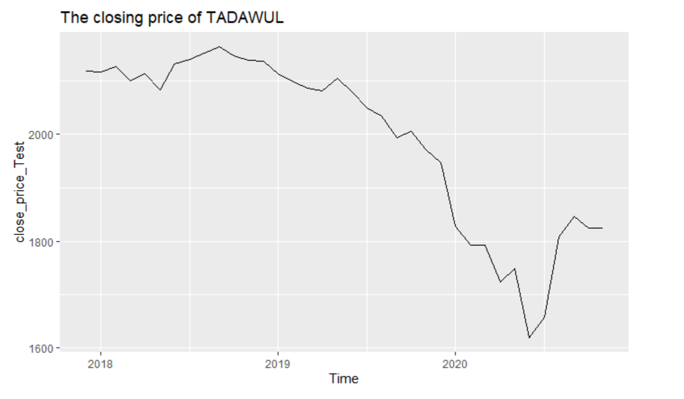
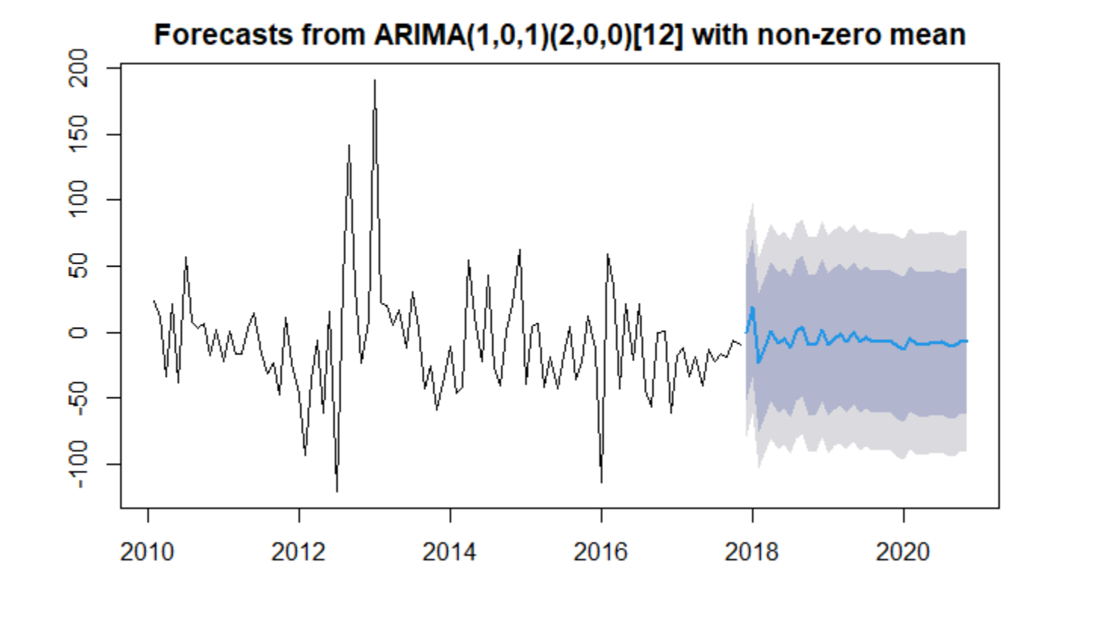
Auto.arima (steps 8-9)
Forecasting the close market price.
The blue line that represents the mean of our prediction for nest 3 years.
*The forecasts are shown as a blue line, with the 80% prediction intervals as a dark shaded area, and the 95% prediction intervals as a light shaded area.
*This is the overall process by which we can analyze time series data and forecast values from existing series using ARIMA.
We can see plotting the test data (2017-2020) the outcome of the forecast (graph on the right)
We can see the known values of the future (test data) (on the left)

Slide 11
RMSE (step 10)
RMSE = 38.95948

Slide 12
Prophet Model
Prophet is a procedure for forecasting time series data based on an additive model where non-linear trends are fit with yearly, weekly, and daily seasonality, plus holiday effects.
*The origin of prophet comes from the application of a forecasting model into supply chain management, sales and economics. This model helps with a statistical approach in shaping business decisions. The Prophet model has been developed by Facebook’s Core Data Science team and it is an open-source tool for business forecasting.

Slide 13
How Prophet works?
The Prophet model is an additive model with the components g(t) models trends, s(t) models seasonality with Fourier series, h(t) effects of holidays or large events.
y(t) = g(t) + s(t) + h(t) + e(t)
g(t) - trend models non-periodic changes; linear or logistic
s(t) - seasonality represents periodic changes; i.e. weekly, monthly, yearly
h(t) - ties in effects of holidays; on potentially irregular schedules ≥ 1 day(s)

Slide 14
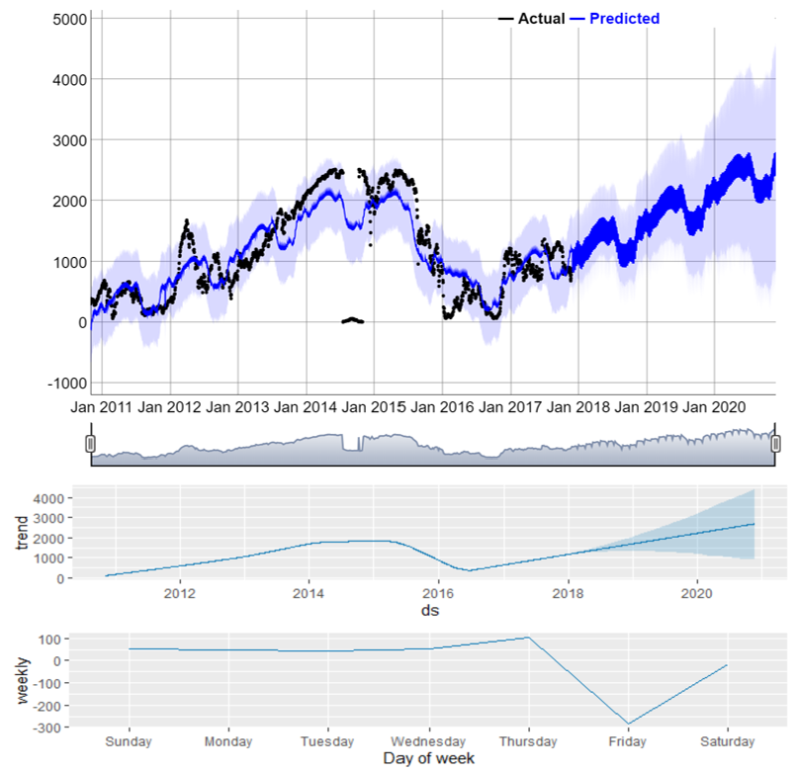
Fitting Prophet model
We can see that the model predicts that the market will have an upward trend in the future, which is not correct based on the data we have and prior knowledge about the market.

Slide 15
RSME
Unfortunately, I was not able to find the RMSE due to incorrect form of data applied to the model.
RSME = NaN

Slide 16
Feed Forward Neural network
Researching deeply in new machine learning models I have reached some new neural network function in the forecast package called nneta
A single hidden layer neural network is the simplest neural networks form. In this single hidden layer form, there is only one layer of input nodes that send weighted inputs to a subsequent layer of receiving nodes. This nnetar function in the forecast package fits a single hidden layer neural network model to a timeseries. The function model approach is to use lagged values of the time series as input data, reaching to a non-linear autoregressive model.

Slide 17
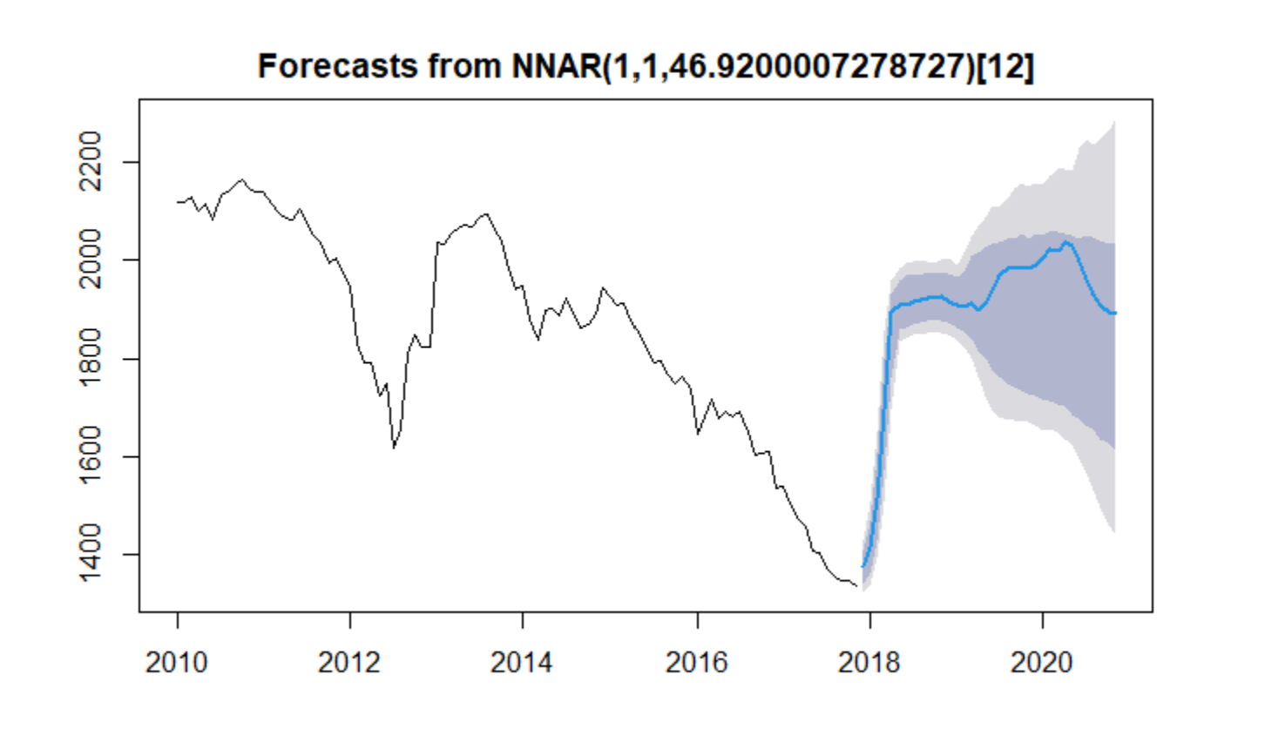
Fitting FFNN model
The outcome has an upward trend that does not match our prediction of the market
RMSE = 43.6

Slide 18
Conclusion
In this project I focused on three different models, learning how to use them with the objective to forecast new price values. As we can see from the results, the models performed with similar future tendency predictions. All the models predicted different tendency of the price future in next 3 years. We can conclude that the ARIMA has the best prediction relatively with the other models based on its RMSE (= 38.95948) and its future predication’s steady to downward slope. Unlike the other two models, they showed either a higher RMSE value or an upward trend in their prediction.

